Slide 1
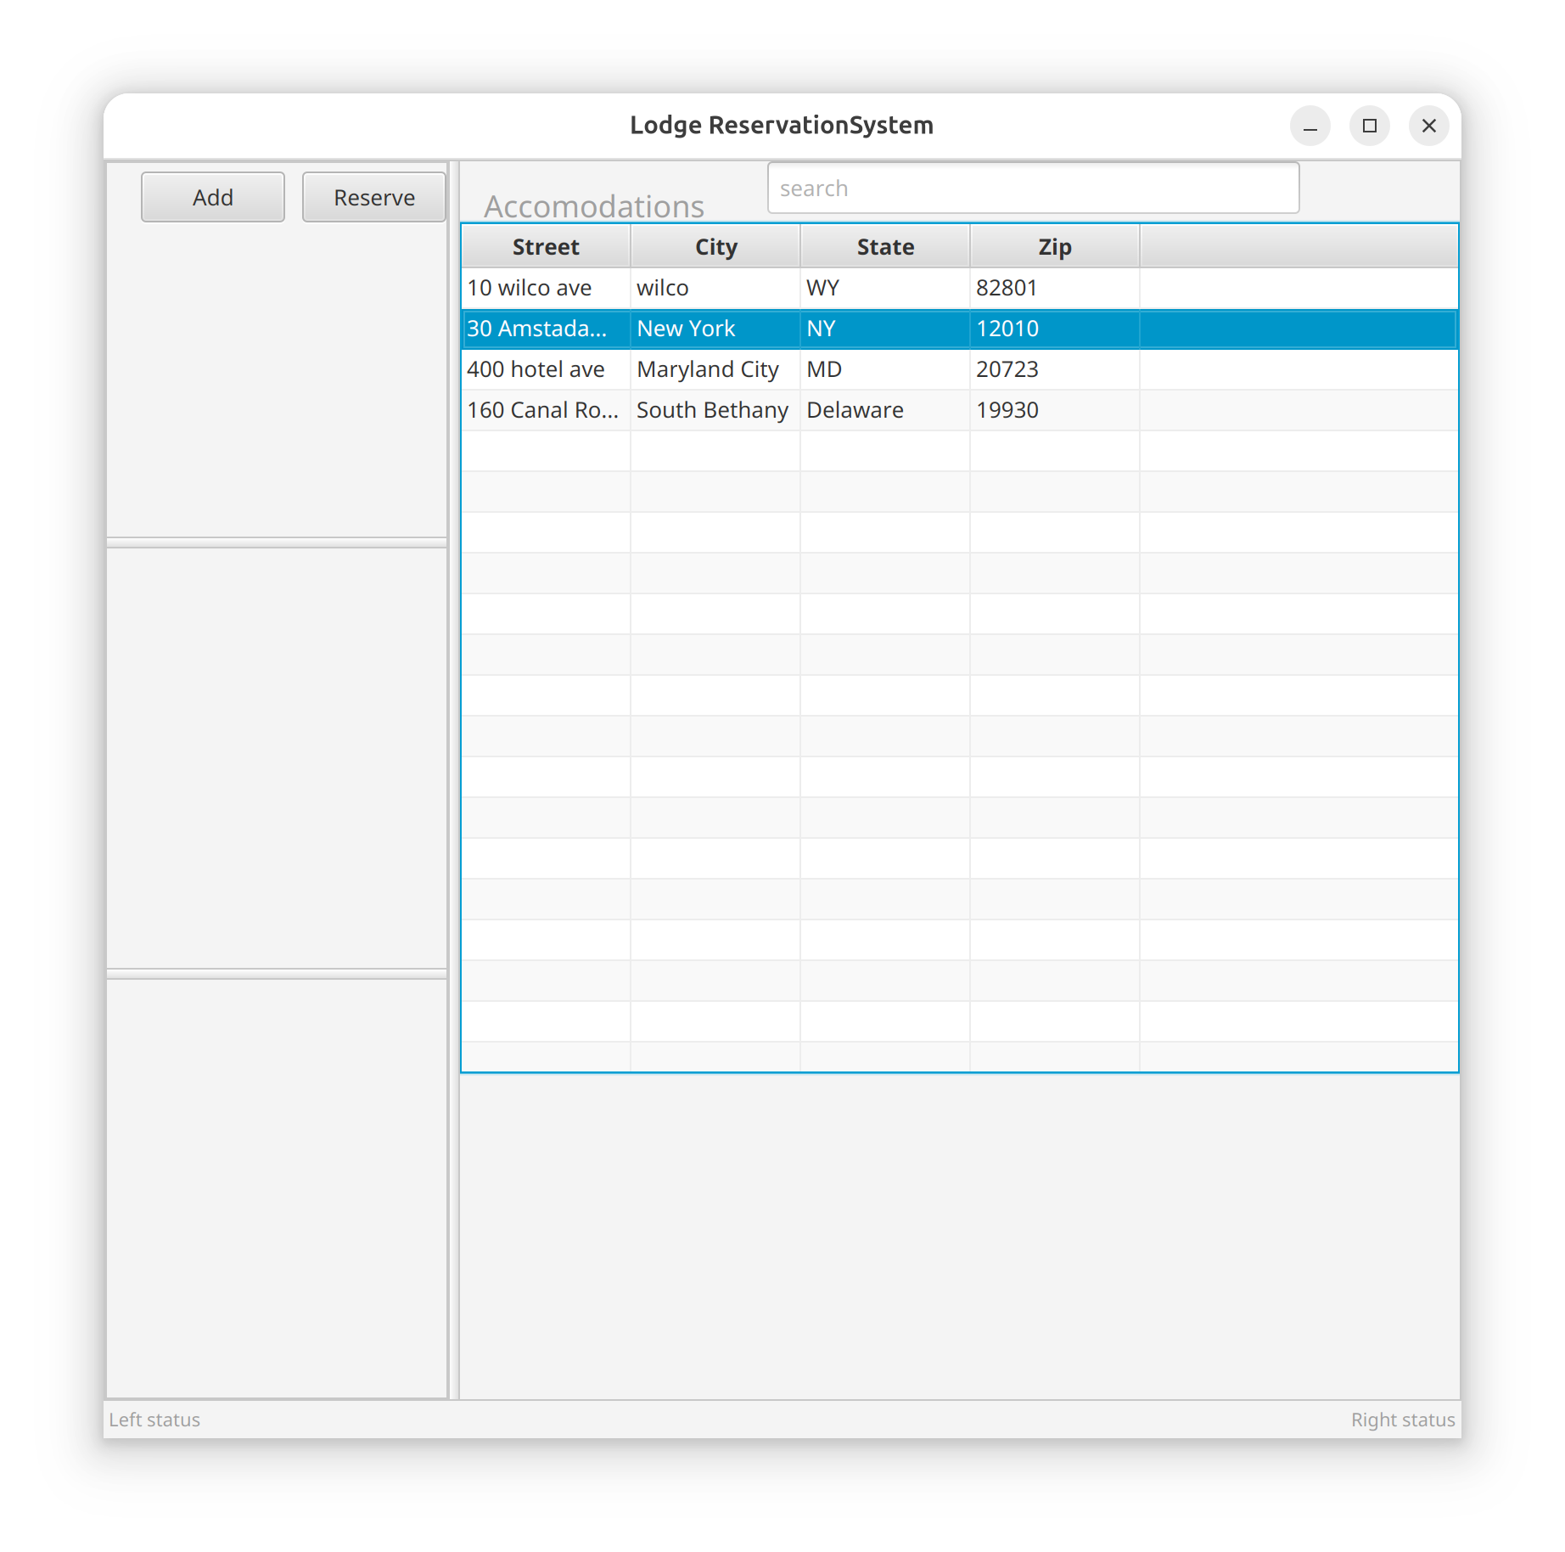
properties
Add reservation
AccountsView
Update Info
Schedule Info
Accounts

